Slide 1


Wellbeing Shorts 1: Worry

Slide 2


Worry
We are living in a very strange time. It is only natural, considering world events, to worry.
Everyone will be worrying to some extent about school, work, health, loneliness and family.

Slide 3

Ruby’s Worry

Slide 4
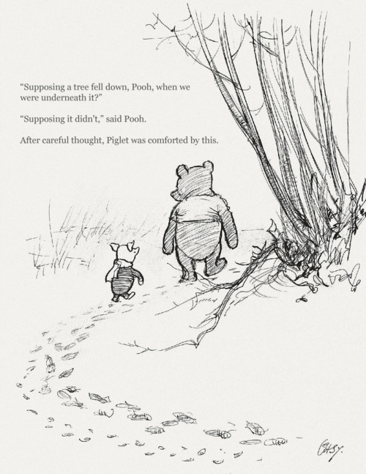
Controlling your thoughts
Some really helpful tools to help you to control negative thoughts and anxiety include..
1. Try to think of happy things
2. Distract your mind – try drawing or colouring or playing a game when you start to worry
3. Talk about your worries and you will find that they get smaller…

