Slide 1
Welcome to
Lower KS2
Willow Class – Mrs Brown, Mrs Patterson & Miss Pearson
Oak Class – Mrs Stock, Mrs Dimmock & Mrs Udoh
Silver Birch Class – Mr Brown, Mrs Dimmock & Mrs Przybylo

Slide 2
The school day
7:30 – Morning Larks Breakfast Club opens (Children must be booked in advance). There is a charge for this.
8:15-8:30 – Early club – free of charge
8:30 – School opens – children to arrive and complete morning jobs
8:55 – Registers are taken. Any children arriving after this point are marked as late
11:00 - Break Time
12:15 - Lunch Time
3:15 - Home time
3:30 – Evening Owls – any child not collected by 3:25 will be taken to Evening Owls and will be charged. Children attending Evening Owls must be booked in advance.

Slide 3
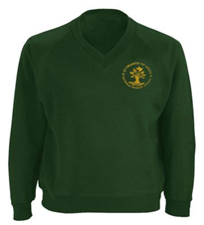
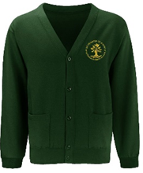
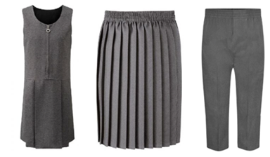
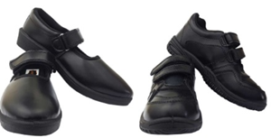
Uniform
jumper with school logo
white shirt and tie
black or grey trousers
all children must wear sensible black shoes
which cover the whole foot
book bag/small rucksack
Please make sure everything is labelled!

Slide 4

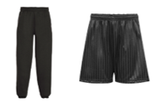
P.E.
PE is on a Tuesday and children should come to school wearing their PE kit.
PE uniform includes:
  green school t-shirt
  black shorts
  black trousers
  trainers or plimsolls

Slide 5
Food and Drink
All children are provided with a water bottle.
Children can bring in a healthy snack for break time which needs to be kept in their book bag/small rucksack until break time.
School dinners must be ordered in advance on the MCAS app. School dinners cost £2.50
Children may bring a packed lunch if they wish to.

Slide 6
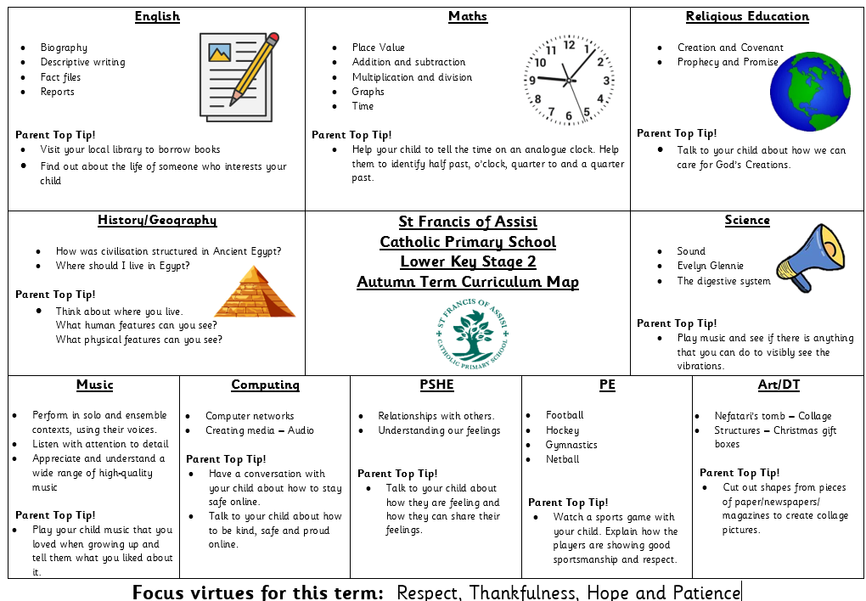
Our Learning

Slide 7
Reading
We offer children the opportunity to read every day in school.
In Lower Key Stage 2 we would love for children read each day at home for at least 20 minutes.
Children have access to the library may bring home library books to support in this.

Slide 8
Writing
Writing is across all aspects of the curriculum.
Children are explicitly taught writing skills in English and they learn to apply these in all other subjects.
Children have multiple writing opportunities to engage with every day.

Slide 9
Maths
Maths takes place in school every day.
Children are exposed to a variety of learning experiences to be able to apply all the skills they learn.
To support your child at home, please encourage them to use TTRS or numbots daily and access any tasks set on IXL.

Slide 10

Worship
Every day the children are invited to join in with three prayers – at the beginning of the day, before lunch and at the end of the day.
Every day, the children take part in Collective Worship.
Children also have two and a half hours of R.E. learning a week.

Slide 11


Homework
Each week we ask that the children complete the following for their homework:
30 questions on IXL – a mix of Maths and English
15 minutes on TTRS
Spelling practice
Daily reading

Slide 12
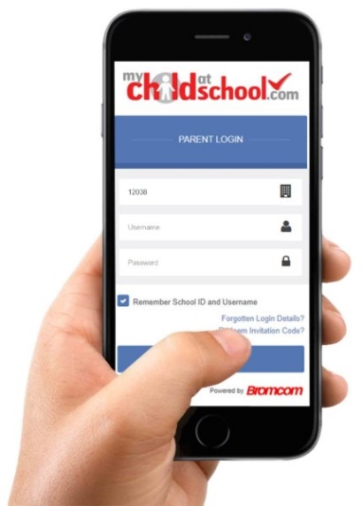
MCAS
My Child at School is a web based portal that all the OLICAT trust schools are using to give parents access to information on their child through a webpage or App. It allows us to keep you up to date about important things in your child’s school life.
When you log in you’ll be able to see:
Your child’s attendance information
Check term dates
Order and pay for lunches
Book parents’ evenings
Book and make payment for Morning Larks and Evening Owls
Give permission for school trips
Book sports clubs and extra-curricular clubs as well as a range of other useful information.

Slide 13

Parents Evening
Tuesday 4th November
Thursday 6th November

Slide 14
Term Dates
Autumn Term 2025
Children return on Wednesday 3rd September 2025 - Friday 19th December 2025
(Half Term week commencing Monday 27th October 2025)
Spring Term 2026
Children return on Monday 5th January 2026 - Friday 27th March 2026
(Half Term week commencing Monday 16th February 2026)
Summer Term 2026
Children return on Monday 13th April 2026 - Monday 20th July 2026
(Half Term week commencing Monday 25th May 2026)
Teacher Training Days for 2025/2026 (School closed to children)
Monday 1st September 2025
Tuesday 2nd September 2025
Friday 21st November 2025
Friday 19th December 2025
Monday 20th July 2026

