Slide 1
Celebration Collective Worship

Slide 2
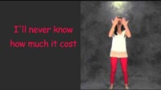

Slide 3
Today we are going to share prayers from our school prayer baskets.

Slide 4
The winning class is…
https://wheelofnames.com/

Slide 5

Virtue Award:
Respect

Slide 6
Birthdays
Year 6 Year 4
Amelia W Zahra
Kacper Teodor
Jayden Azariah
Year 5 Year 3
Daria Logan
Sana Abigail
Natalia Melanie
B

Slide 7
Houses: we are ALIVE
Autonomy
Language
Inclusion
Experience
Virtue

Slide 8
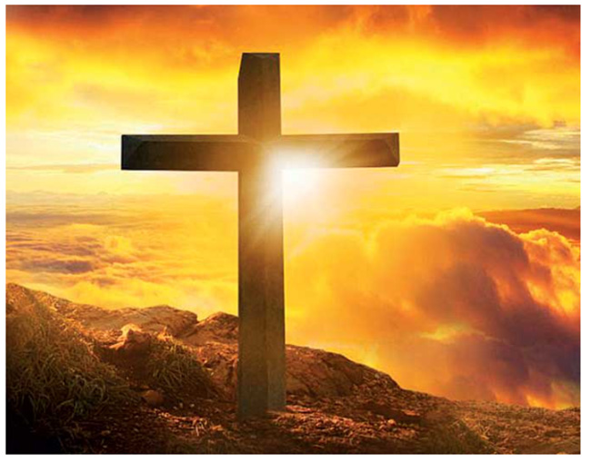
Final Prayer
End of day prayer
God our Father,
I come to say,
Thank you for your love today.
Thank you for my family,
And all the friends you give to me.
Guard me in the dark of night
And in the morning
Send your light.
Amen
Let us pray
Help us Lord to be thankful the food and drink you have given us. Enable us to work for the common good, so that we may share what we have with those who need it most.
Amen

