Slide 1
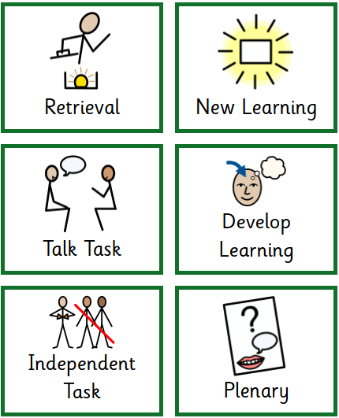
Retrieval!
What is our current virtue?
How can we show this virtue daily in school?
Our current virtue is…
I can show this virtue in school by….

Slide 2

Today we are going to be …
Continuing to think about respect

Slide 3
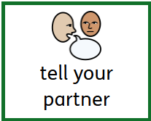
Star Words!
Respect
Treat/Treatment/Treating
Home
Community
Neighbour

Slide 4
What does respect mean in our community?
Respect
Treat/treatment/treating
Home
Community
Neighbour
In our community we show respect by….

Slide 5
What is Harvest?
How does it link with our virtue of respect?
Respect
Treat/treatment/treating
Home
Community
Neighbour
Harvest is….
It links to our virtue of respect because….

Slide 6
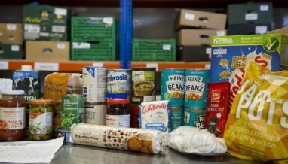
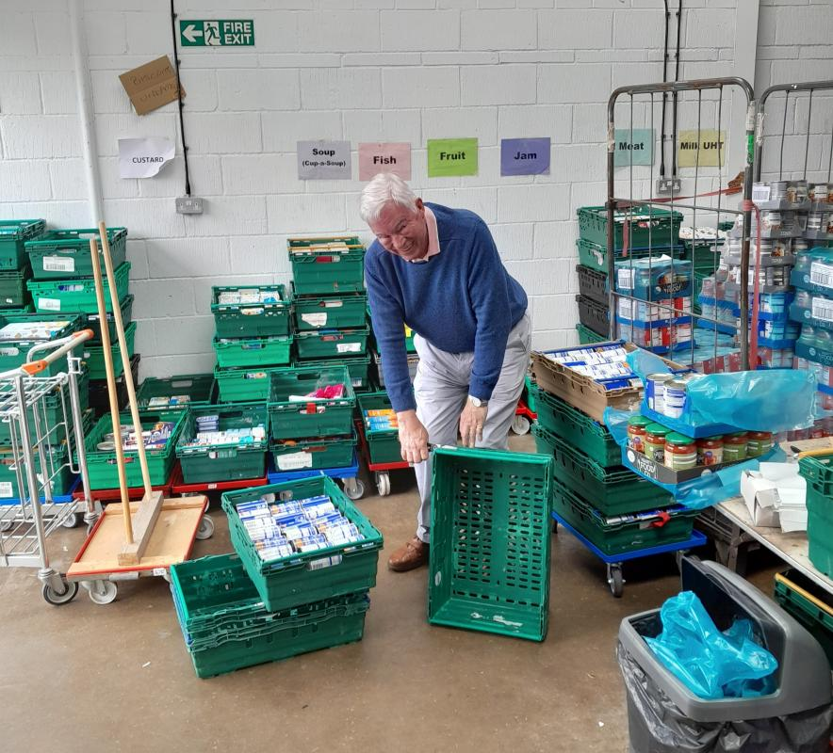

The Bedford Foodbank
Respect
Treat/treatment/treating
Home
Community
Neighbour
I can help the Bedfrod Foodbank by….

Slide 7



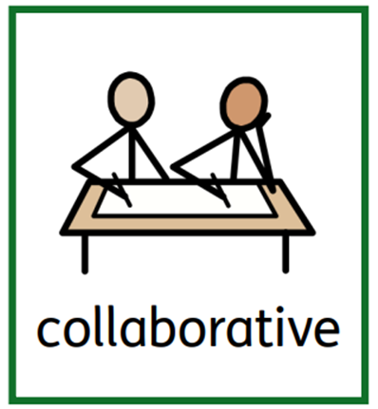




What do you remember about our
Our Learning 8?

Slide 8


Talk Task!
I have shown I am engaged and motivated this week by….
I have supported others to be engaged and motivated by….

Slide 9
Colours of day dawn into the mind
The sun has come up, the night is behind
Go down in the city, into the street
And let's give the message to the people we meet
So light up the fire and let the flame burn
Open the door, let Jesus return
Take seeds of His Spirit, let the fruit grow
Tell the people of Jesus, let His love show

Slide 10
Go through the park, on into the town
The sun still shines on, it never goes down
The light of the world is risen again
The people of darkness are needing a friend
So light up the fire and let the flame burn
Open the door, let Jesus return
Take seeds of His Spirit, let the fruit grow
Tell the people of Jesus, let His love show

Slide 11
Open your eyes, look into the sky
The darkness has come, the Son came to die
The evening draws on, the sun disappears
But Jesus is living, His Spirit is near
So light up the fire and let the flame burn
Open the door, let Jesus return
Take seeds of His Spirit, let the fruit grow
Tell the people of Jesus, let His love show

Slide 12

We will say together our home time prayer.

