Slide 1
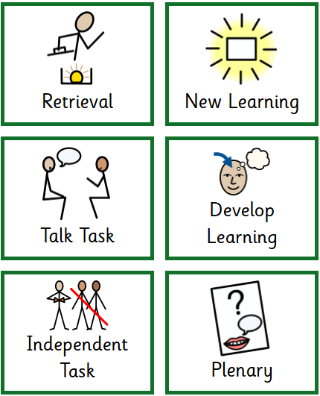
Retrieval!
What is our current virtue?
How can we show this virtue daily in school?
Our current virtue is…
I can show this virtue in school by….

Slide 2
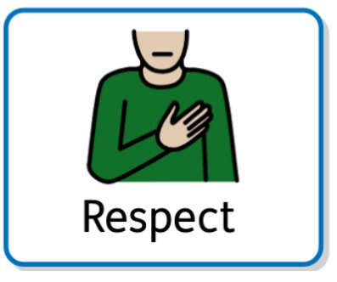
Today we are going to be …
Continuing to think about respect

Slide 3
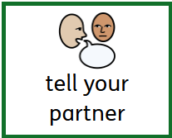
Star Words!
Respect
Treat/Treatment/Treating
Home
Community
Neighbour

Slide 4
What does respect mean in our community?
Respect
Treat/treatment/treating
Home
Community
Neighbour
In our community we show respect by….

Slide 5
What is Harvest?
How does it link with our virtue of respect?
Respect
Treat/treatment/treating
Home
Community
Neighbour
Harvest is….
It links to our virtue of respect because….

Slide 6
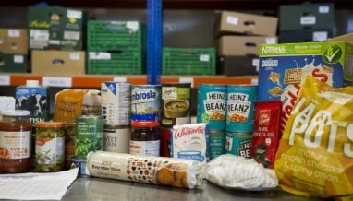
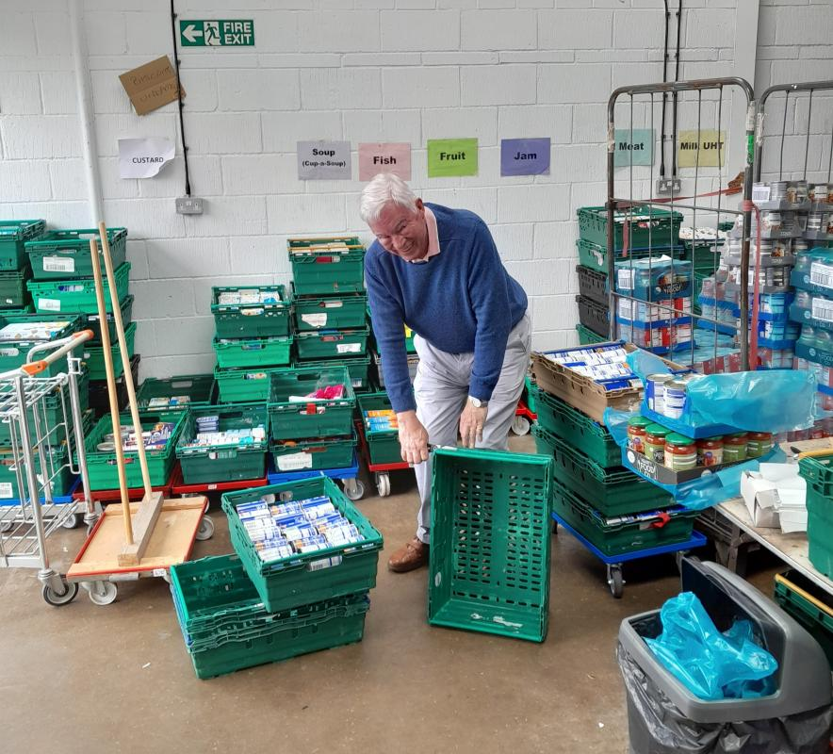

The Bedford Foodbank
Respect
Treat/treatment/treating
Home
Community
Neighbour
I can help the Bedfrod Foodbank by….

Slide 7
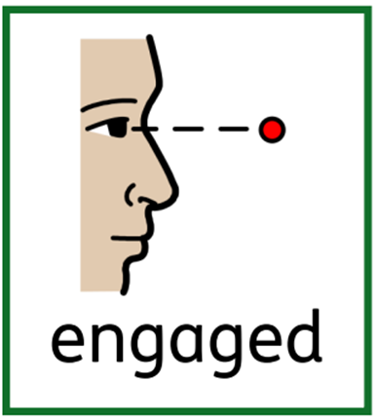


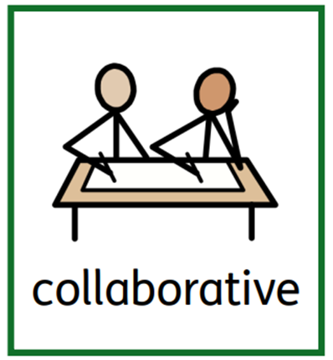

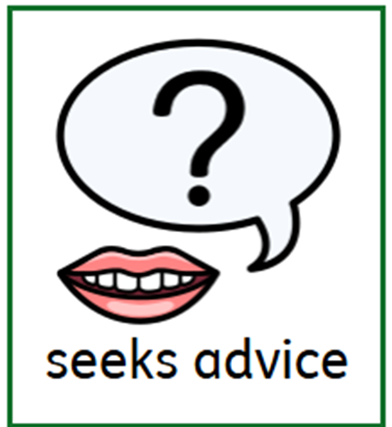

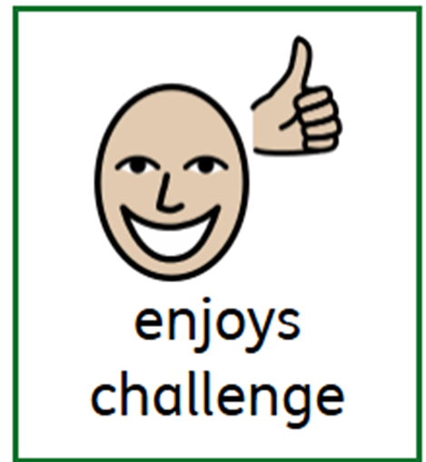
What do you remember about our
Our Learning 8?

Slide 8
Talk Task!
I can show I am supportive and collaborative by….
Being supportive and collaborative shows respect because….

Slide 9
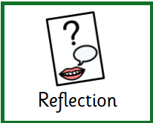
We will say together our home time prayer.

